Slide 1
How to use this briefing:
Delete this instruction slide and use the remaining slides to introduce your co-workers to the CFC in a virtual or in-person meeting.
Use the suggested script provided in the notes section of each slide. (Fill in your unique information in the notes section of slides 3 and 11.)
Practice giving this presentation, so you get comfortable with the material before your meeting.
Reach out to a CFC staff member if you have any questions or need any help.

Slide 2
Welcome to the 2022
Combined Federal Campaign (CFC)
National Campaign Dates:
Sept 1, 2022 – Jan 14, 2023
Notes:
Hello everyone. My name is [introduce yourself]. I am serving as our Combined Federal Campaign (CFC) point of contact this year. Thank you for giving me a few minutes today to talk to you about the campaign.

Slide 3
The CFC needs
YOU!
Notes:
The CFC needs you. It needs all of us, actually. The CFC is a federal tradition that’s been around for more than 60 years. Through the campaign, federal employees like us give tens of millions of dollars every year to charities we care about. Together, we change the world one donation at a time.

Slide 4



HOW THE CFC WORKS
- FOR DONORS -
CHOOSE YOUR CAUSE
MAKE YOUR PLEDGE
CHANGE THE WOLRD
Notes:
We have made the CFC one of the largest and most successful workplace giving campaigns in the world.
Here's how it works:
First, Choose your cause. Whether you care about finding cures for diseases, supporting military families, or promoting equality for all, the CFC has vetted charities for any cause you want to support. You can even give to multiple charities with one pledge.
Second, Make your pledge. The most popular giving option, the online pledge portal, allows you to easily renew your pledge each year and offers the full range of pledge options: Including; Payroll deduction (the most popular!), Credit/debit card, E-check/bank transfer, Volunteer hours.
Lastly our donations will change the World, making it a better place for all of us.

Slide 5
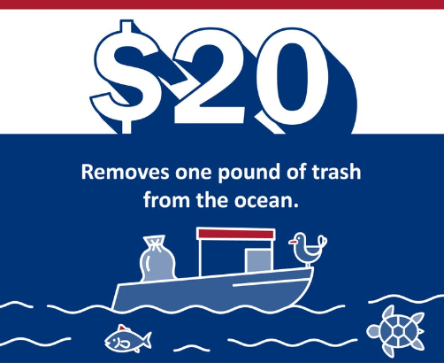
HOW YOU CAN HELP
Example 1
Notes:
Here's one example of how you can change the world through the CFC: just $20 removes one pound of trash from the ocean.

Slide 6
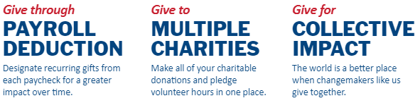
WHY THE CFC?
Notes:
The reasons we give, how we give, and where we give will each be unique. So, you might be wondering why should you give through the CFC?
There are three main reasons:
First, you can give through payroll deduction which helps you give a little each month and adds up over the course of the year.
Second, you can give to multiple vetted charities with one donation - and even pledge volunteer hours!
And of course, the biggest reason of all is that when we give together, all our donations add up to a lot!

Slide 7
THE CFC IMPACT
$78.1
MILLION
80,000
VOLUNTEER HOURS
5,000+
CHARITIES
Notes:
When we all give together, we have a HUGE collective impact. ​Just last year, monetary contributions reached nearly $78.1 million. This is in addition to the 80,000 hours of volunteer service hours federal employees pledged to more than the 5,000 CFC-listed charities.
Since its inception, the CFC has raised more than $8.6 billion for charities and people in need.

Slide 8
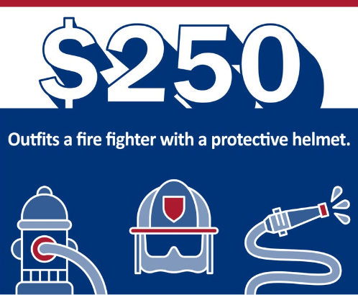
HOW YOU CAN HELP
Example 2
Notes:
Here's another example of how you can change the world through the CFC. Did you know that $250 can outfit a firefighter with a protective helmet, allowing them to stay safe while saving lives.
If you choose to give via payroll deduction, that is just a little over $10 per pay period. (or for military members, you can say a little more than $20 per month).

Slide 9
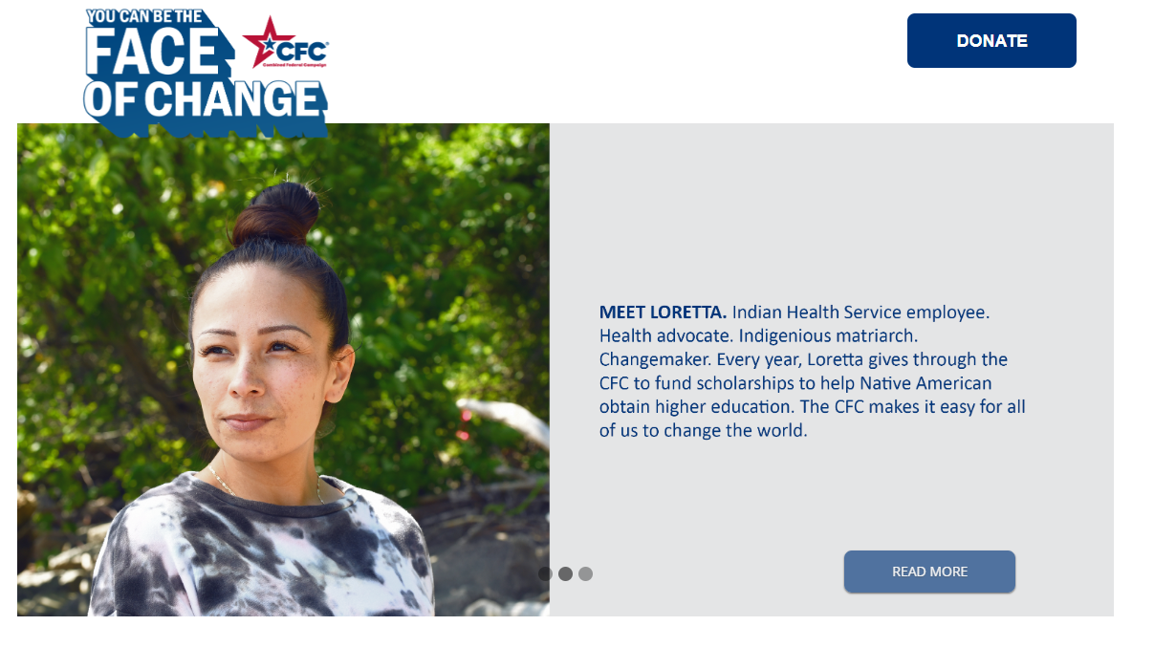
HOW TO GIVE: ONLINE PLEDGE PORTAL
Notes:
I've talked about why the CFC is important and how you can be the face of change through your donation. Now let's talk about how you join the CFC. Whether through payroll deduction (the most popular option), credit card, e-check, or even supplementing your monetary gift with pledging volunteer time, when giving through the CFC, the choice is yours. You get to decide if it will be a one-time gift or recurring contribution. My favorite way to give is by payroll deduction through the online portal, which is the easiest and most comprehensive way to make a difference. You can access it by clicking the Donate button on the website: GiveCFC.org.

Slide 10
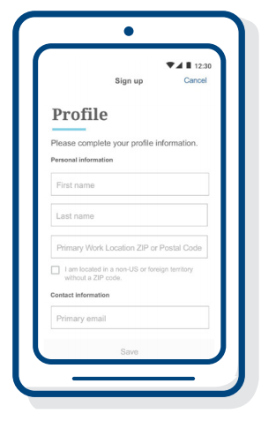
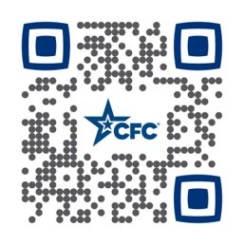
How to Give: CFC Giving Mobile App
How to Use It:
Download the App
Sign in or create an account
Search for charities
Give
Complete your donation
Notes:
You also have the option to donate through the CFC Giving Mobile App. The CFC Giving Mobile App was primarily designed to take the place of one-time cash donations at CFC events, but now it offers a full selection of donation options. You can scan this QR code right now to download the app to your IOS or android device.

Slide 11
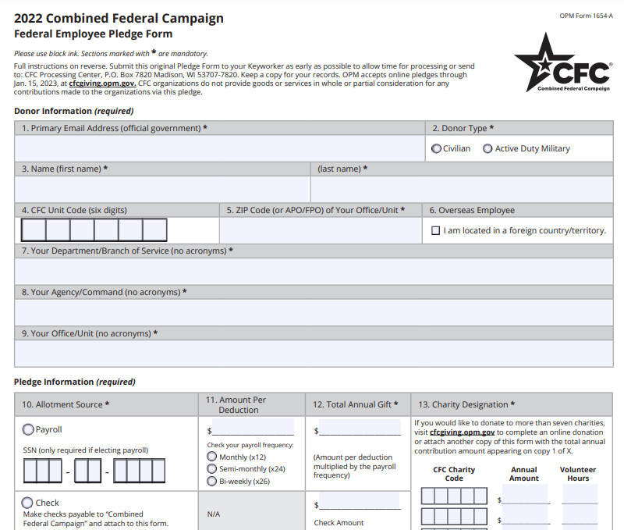
How to Give: Paper Pledge Form
CFC Unit Code
ZIP Code
Notes:
Of course, you can still donate with the paper pledge form. You can download a paper pledge form from the website (or let me know if you would like one) and then when you fill it out, you can return it to me or you can mail it directly to the CFC pledge processing center.
Use our CFC unit code and office ZIP code to ensure our unit/office receives credit for your contribution. Our unit/office CFC code is:

Slide 12
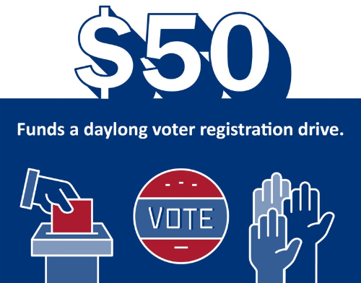
HOW YOU CAN HELP
Example 3
Notes:
And here's a final example of how you can change the world through the CFC: $50 funds a daylong voter registration drive.

Slide 13
Thank you for being the face of change.
Notes:
Thank you so much for allowing me to talk with you today about the CFC. The campaign is a great opportunity for each of us to give back to the causes that are important to us. Speaking of causes, each week during the campaign, the CFC highlights a cause of the week. Be on the lookout from me for emails about these causes and other information about the CFC. And, I am always available to answer any questions you may have or help you with your pledge.

